Slide 1



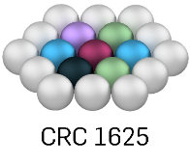

Research Data Management System (MatInf):
Materials Data Infrastructure
Victor
Dudarev
V. Dudarev, A. Ludwig

Slide 2
Agenda Part I Agenda Part II (MDI)
Requirements;
Object type system:
  Build-in types;
  User-Defined Types;
  Templates;
  UDT-support services:
    Validation;
    Data Extraction;
    Visualization.
Architecture;
Batch upload;
Graph;
API;
Conclusion;
Q&A.
What we do;
Research workflow;
Sample workflow;
Data Integration;
Handovers;
Data publication;
Live Demo;
Q&A.

Slide 3
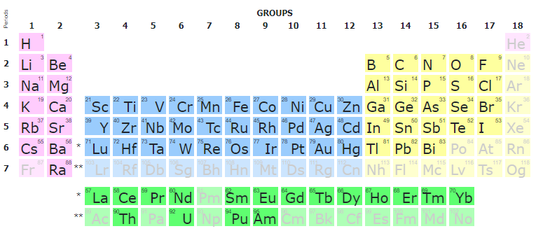
Materials Science Specifics
Basic domain entities:
System
(qualitative composition)
Co-O
Substance
(quantitative composition)
Co₃O₄
Modification
(crystal structure type)
Feature: search for a composition within a specified range.
Search criteria example: Co_{2.7-3.3}O_{X} should find Co₃O_{4.}
β-Co₃O₄
…

Slide 4
Flexibility and Extensibility
Motivation: support evolving research challenges:
- new entities / sample types
- new measurements (new devices/document formats)
- enable data integration (across different )
Solution: flexible, but strict (constraints enforcement) data model

Slide 5
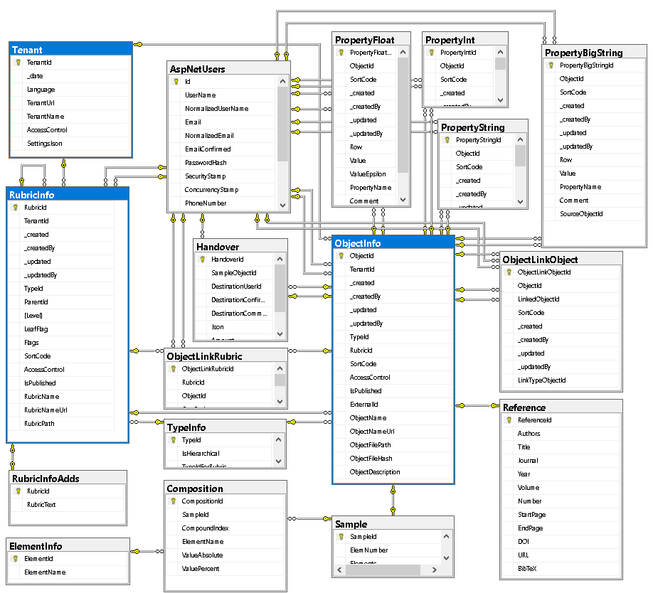
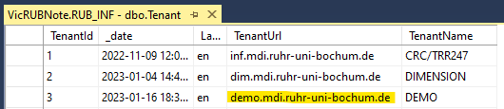
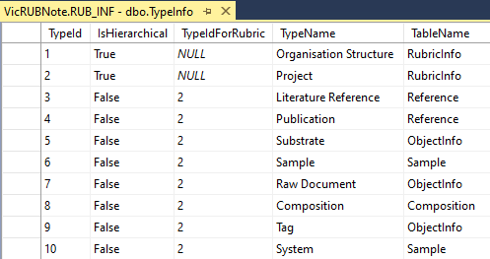
Database Schema
Tenants (independent systems; tenants can share a single DB or have an individual DB per tenant):
Every tenant must have a unique URL!
Object Types (shared among tenants in a single DB):
ASP.Net Code Identity part (AspNet*) is omitted.

Slide 6

Ways of customization
Basic (no-code)
  Introducing User-Defined Data Types:
    - List templates
    - Table templates
Shortly illustrated in today’s talk
Simple (client-side code only)
  Page-code injection:
    - HTML
    - Javascript
    - CSS
Development abstraction layers
easy hard
data layout workflow application
External API (server-side code only)
  Validation & Data Extraction for User-Defined Data Types (any language)
Complex (client- & server-side code)
  INF-code adjust (ASP.Net Core App)
    - C#
    - SQL
    - HTML/Javascript/CSS
Complexity

Slide 7


User-Defined Type Support
Motivation: to support new user-defined object type (UDT)
without modifying core RDMS source code
Given: New object type with/without a new arbitrary file format (could be new measurement type result).
Solution (or 5 keys to success):
Templates – define object model (data structure) in terms of key-value pairs / table (properties)
Search – enable search for UDT objects based on defined data model
Validation – provide check for data correctness (valid/invalid)
Data Extraction – if valid, extract data in terms of properties / related object creation
Visualization – display data, including drawing charts / diagrams, etc…
UDT – user-defined type

Slide 8
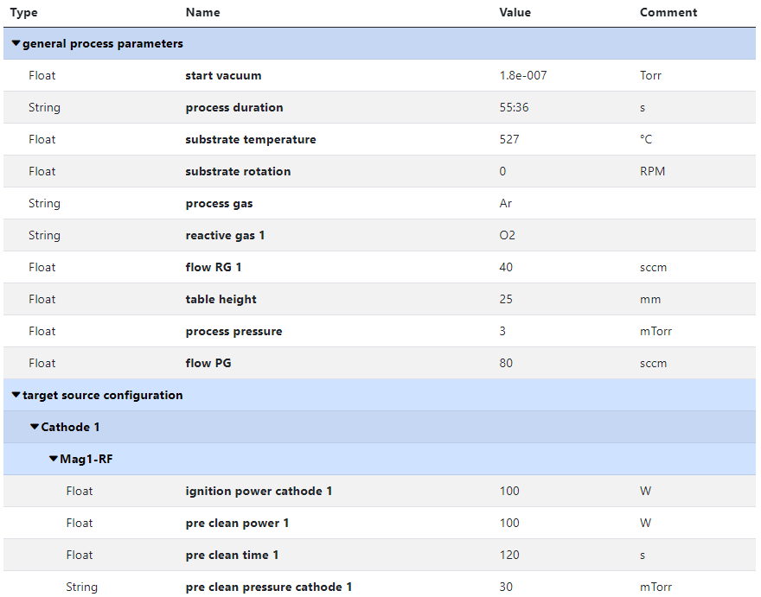
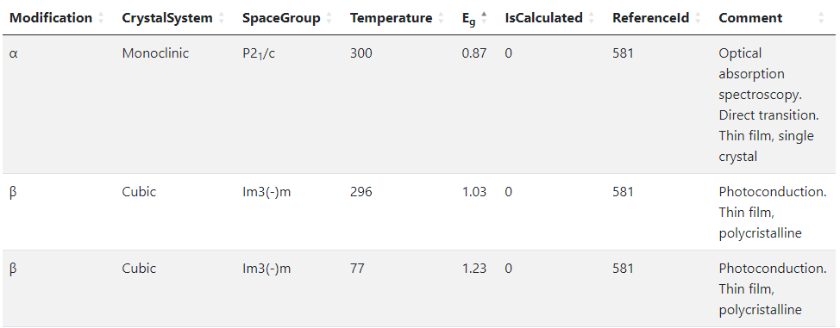
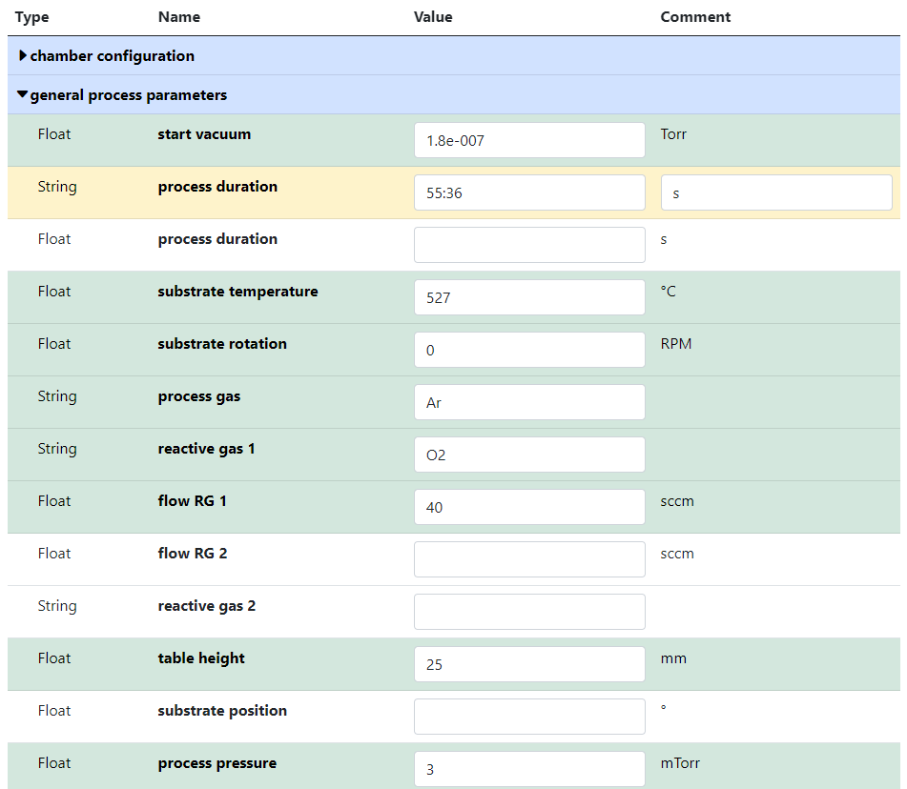

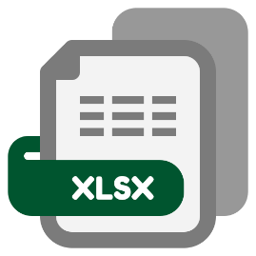
No-Code Customisation: Object Type Template
Template
List
(specify sorted properties list with separators)
Create an object with “_Template” name
Specify properties set for a type
Table
(specify table structure: columns & types)
Data in a table with predefined structure
Key-value pairs
https://inf.mdi.ruhr-uni-bochum.de/object/250415-k2-1-32328
https://demo.mdi.ruhr-uni-bochum.de/object/ag2s-4870

Slide 9
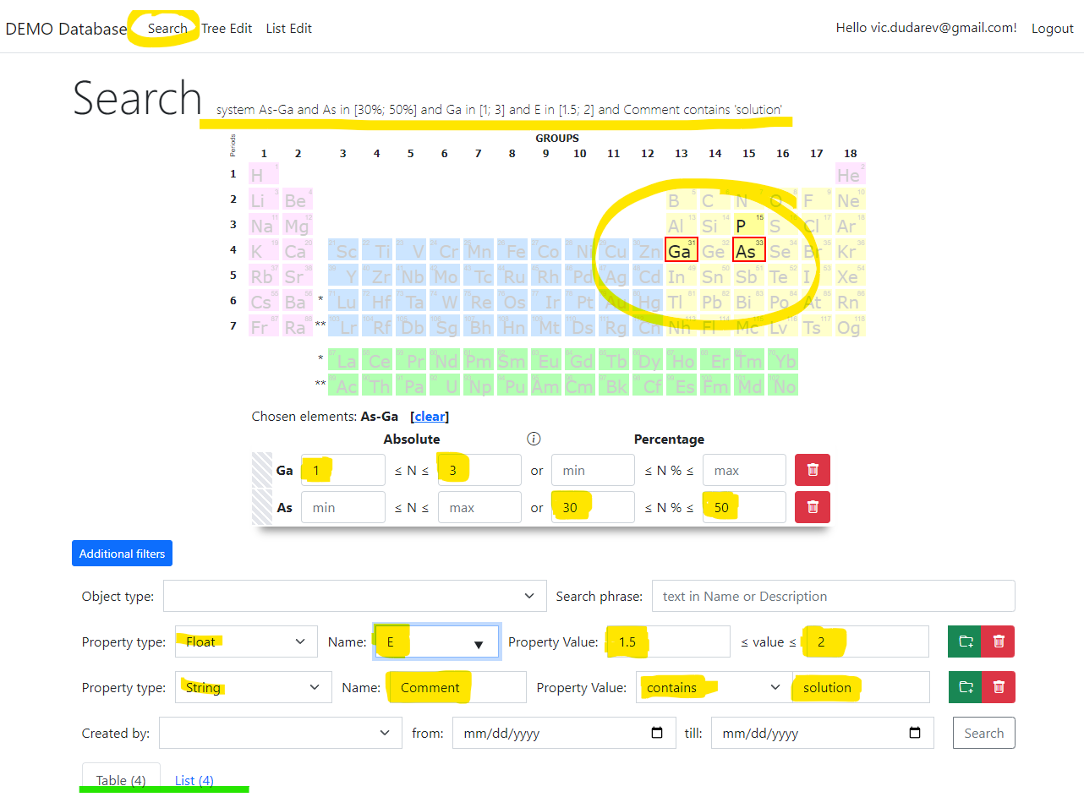
Search
Search on:
Chemical system
Composition
Object type
Phrase in object’s Name or Description
Properties values (all available within tenant)
Person created
Creation date
Research graph
...
Important feature:
persistent URL on search (share search results easily by URL*).
* - respecting current security context
https://demo.mdi.ruhr-uni-bochum.de/search/?system=As-Ga&typeid=8&Aspctmin=30&Aspctmax=50&Gaabsmin=1&Gaabsmax=3&pr0name=E%3Csub%3Eg%3C%2Fsub%3E&pr0type=Float&pr0min=1.5&pr0max=2&pr1name=Comment&pr1type=String&pr1max=3&pr1str=solution&prcnt=2

Slide 10

Documents workflow: Standardisation, Testing, Extraction
Failure
Type-dependent mechanisms
fail
document
MatInf RDMS
Data
validation
user
/ API
ok
Data extraction
JSON
Persisting
(document + data)
objects
properties
Database
document
View
SHA-256
link
File
storage
Data visualisation
document
HTML

Slide 11
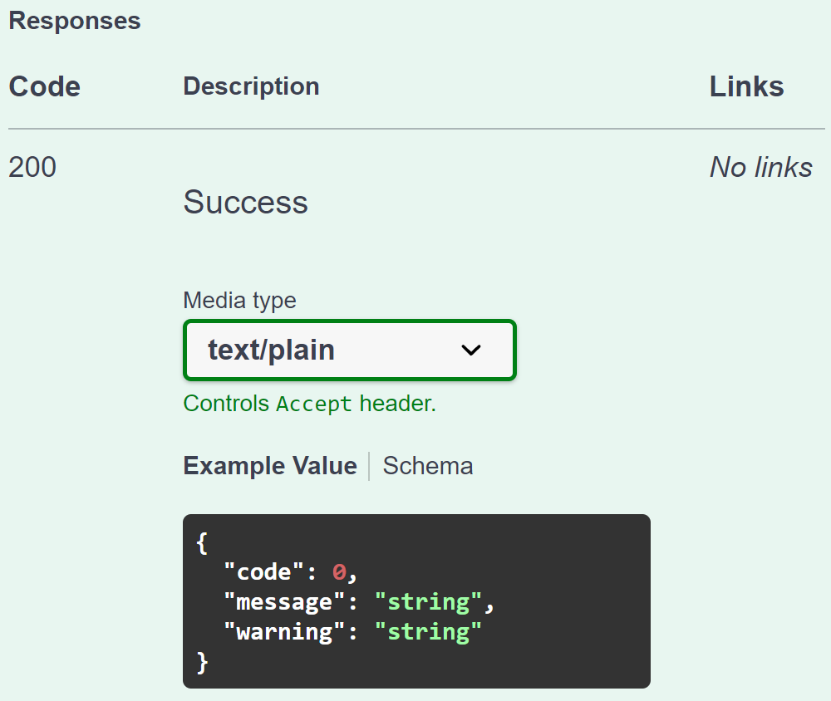
RDMS UDT API: Validation flexibility
Provide a validator for every object type in configuration:
type: built-in type (object instantiated by class name);
https: URL to a REST Service (OpenAPI specification).
type:TypeValidationLibrary.TypeValidator_EDX_CSV (interface IFileValidator)
{
"Code": 0,
"Message": null,
"Warning": null
}
https://validation.matinf.pro/edx/validation
valid
Validation result
via external API call
invalid
External service decision
type
{
"Code": 500,
"Message": "error text",
"Warning": null
}
API – Application Programming Interface
URL – Uniform Resource Locator
REST – REpresentational State Transfer

Slide 12
UDT configuration: Data Extraction (external Web Service)
Data extraction & conversion to table tasks are delegated to an external service
Data Extraction
Request URL: HTTPS_DataSchema + ("/databasevaluesbody" | "/tablebody")
Example: Data Schema (for EDX): https://validation.matinf.pro/edx/data
/databasevaluesbody
/tablebody
Data
IDatabaseValuesGetter: properties, compositions, properties for measurement areas
Table
ITableGetter: arbitrary table
(used for table visualisation)
Request URL (data): https://validation.matinf.pro/edx/data/databasevaluesbody Request URL (table): https://validation.matinf.pro/edx/data/table
Data schema values (examples):
{
"DataTable": [
{
"Index": "1",
"V": 31.3,
"Mn": 2.7,
"Co": 22.6,
"Ni": 6,
"Ho": 37.4
},
...
],
"Coordinates": {
"CoordinateNames": [],
"HasCoordinates": false
},
"Dependencies": {
"DependencyNames": [
"Index"
],
"HasDependencies": true
}
}
Data Schema | Comments
type:TypeValidationLibrary.TypeValidator_EDX_CSV | EDX Extraction via Reflection (dynamic class invocation)
https://validation.matinf.pro/edx/data | EDX Extraction
https://htts.matinf.pro/resistance/csv/data | HTTS Resistance CSV
https://htts.matinf.pro/resistance/txt/data | HTTS Resistance TXT
https://thickness.matinf.pro/thickness/xlsx/data | Thickness XLSX
https://thickness.matinf.pro/thickness/txt/data | Thickness TXT
https://validation.matinf.pro/

Slide 13
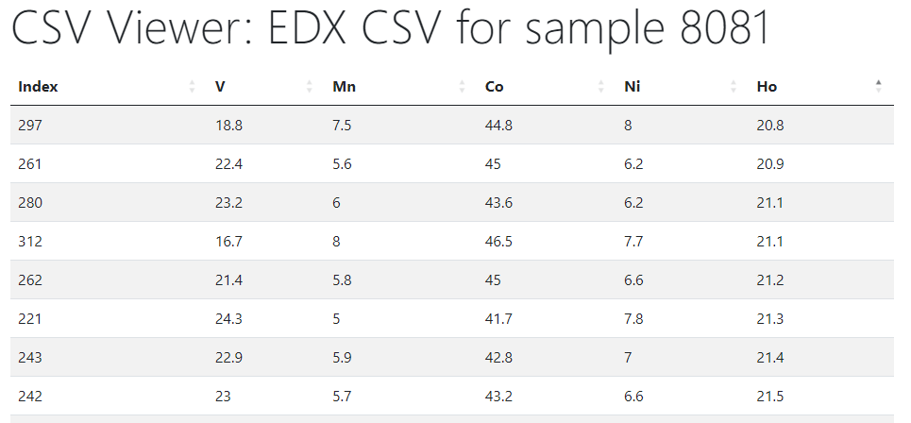
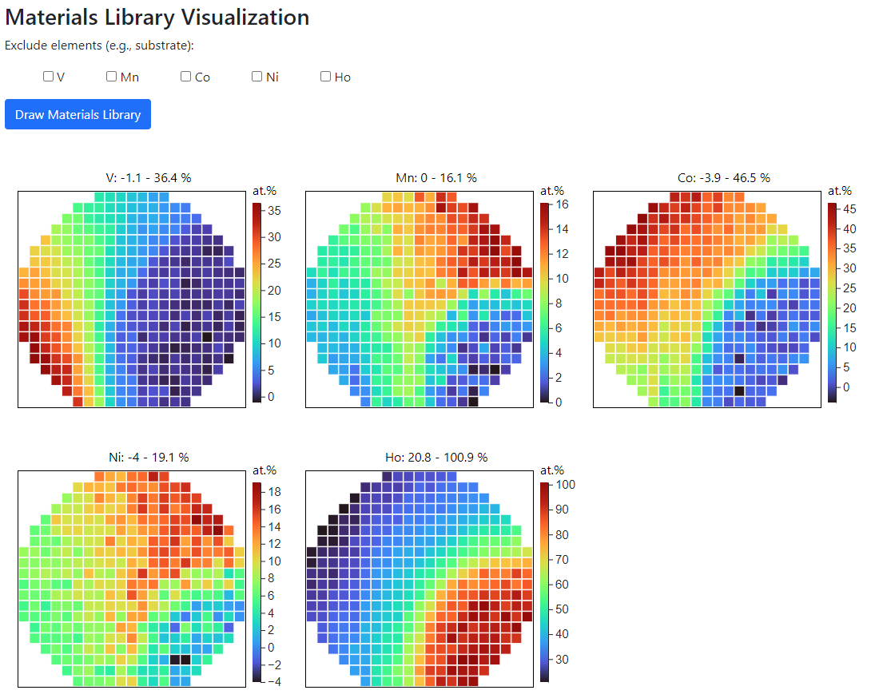
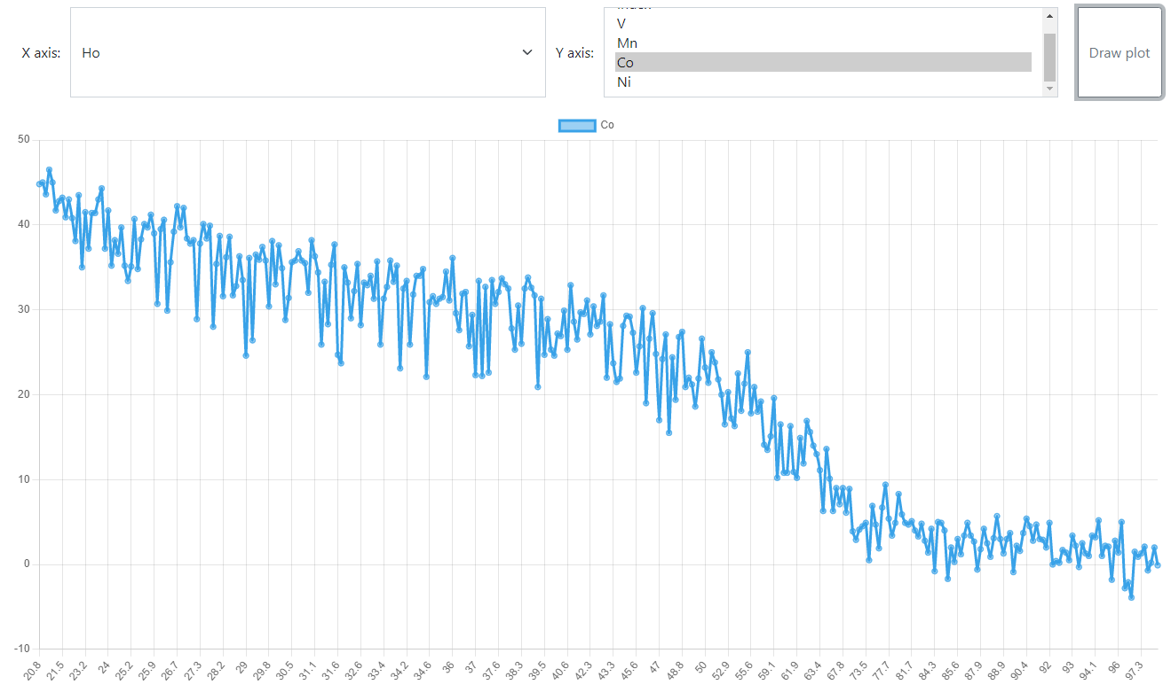
RDMS: Data Visualization
Materials Library Visualization
Configurable XY-charts
https://dim.mdi.ruhr-uni-bochum.de/file/csv/6691

Slide 14
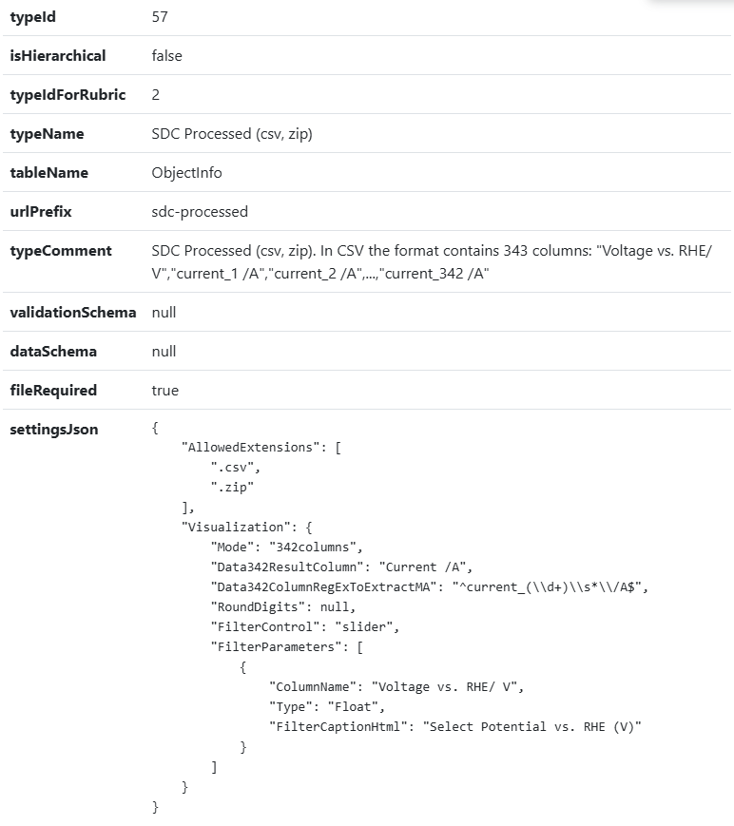
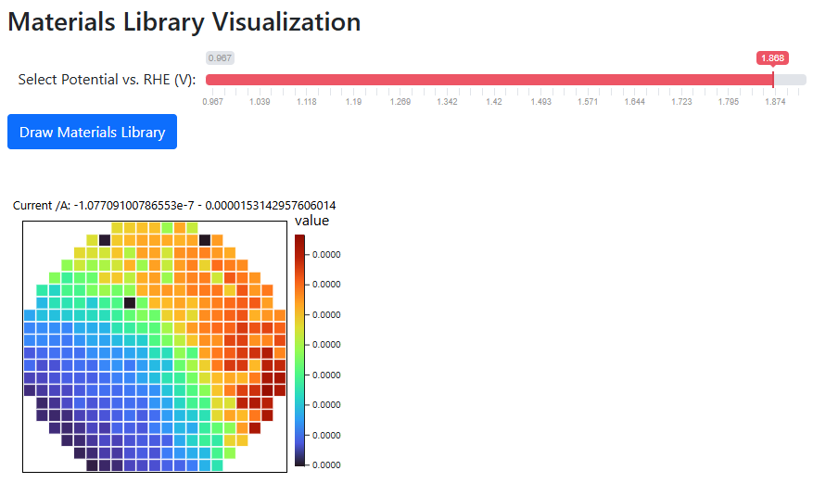
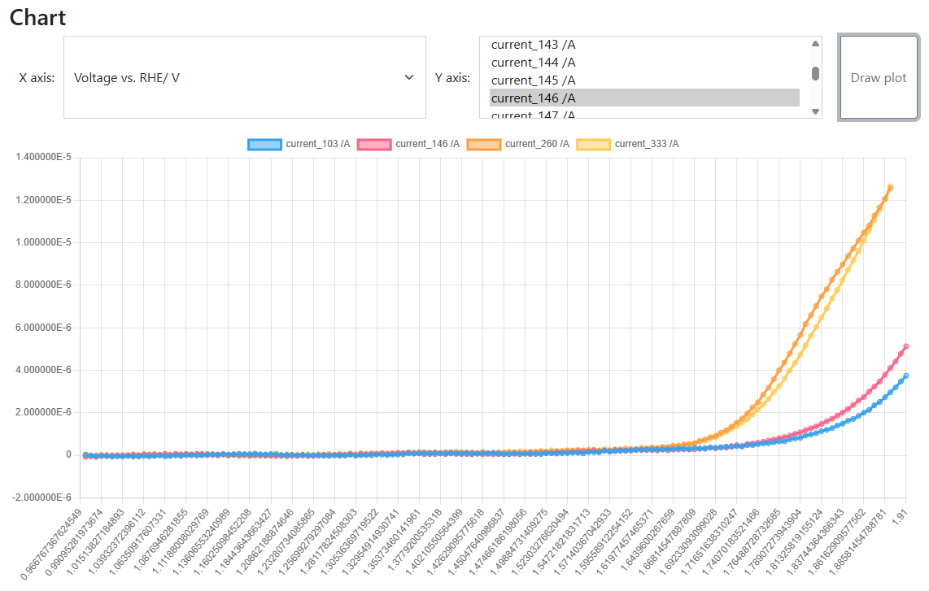
Sliders in data visualizations
Goal: Implement interactive data visualization
Use case:
SDC Processed (csv, zip) type
CSV with fixed format
Strange things in experiments (discovery or mistake?):
https://crc247.mdi.ruhr-uni-bochum.de/file/csv/22677
https://crc247.mdi.ruhr-uni-bochum.de/file/csv/22674
Quality Assurance
(personal responsibility)
SDC Processed (csv, zip): https://crc247.mdi.ruhr-uni-bochum.de/object/20250204_0010671_colanio_ph12_8_oer_lsv_eis-22680
Visualization with a slider: https://crc247.mdi.ruhr-uni-bochum.de/file/csv/22680

Slide 15


MatInf Architecture
Application Services
Web Application
users
API
Controller
View
Visualisation
service
Web API Services
API
Model
API
service
agents
Validation
service
Data Access Layer
API
Data Extraction
Dapper
IO (SMB/S3)
service
External Type Support Services
Database
File Storages
Database
Databases
Storage Services
MatInf – Research Data Management System
API - Application Programming Interface;
SMB - Server Message Block;
S3 - Simple Storage Service.

Slide 16
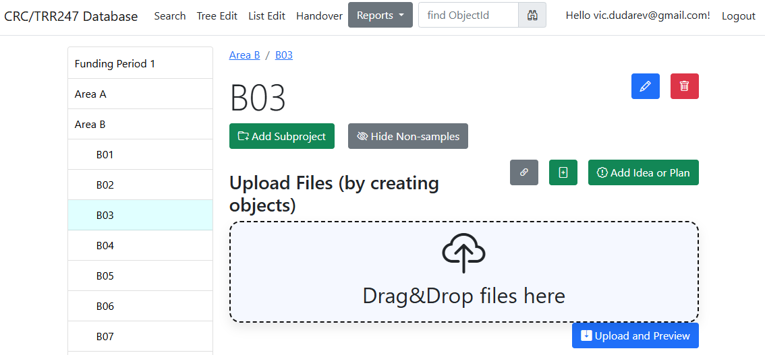

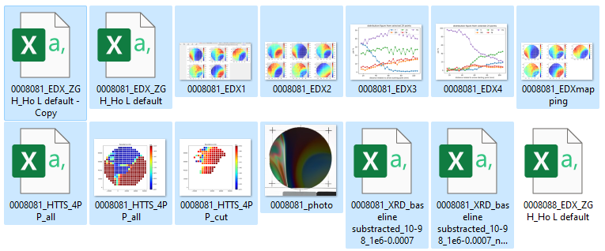
RDMS DropZone Tasks: Batch Data Validation & Import
Task: validate documents & import data
Implemented Features:
Automatic type detection (by file name)*;
  Type name and file name are split into words:
  10 points for each complete word match
  1 point for every substring match to
  Highest score type wins!
Uniqueness check (object name + file);
Data validation (build-in + external);
Data import.
Every name (type name and file name) is split into words using non-alphabetical characters as delimiters, and then the score is calculated:
- If the word matches completely, then we add 10 points to the score
- If the word in the file name is a substring of the word in the type name (or vice versa), then we add 1 point to the score.

Slide 17
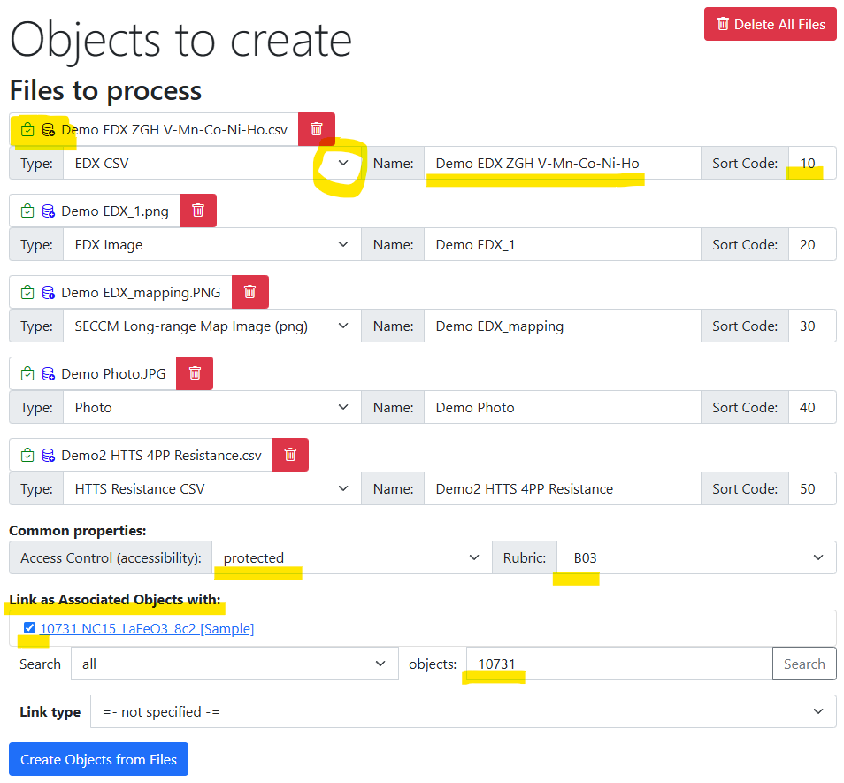
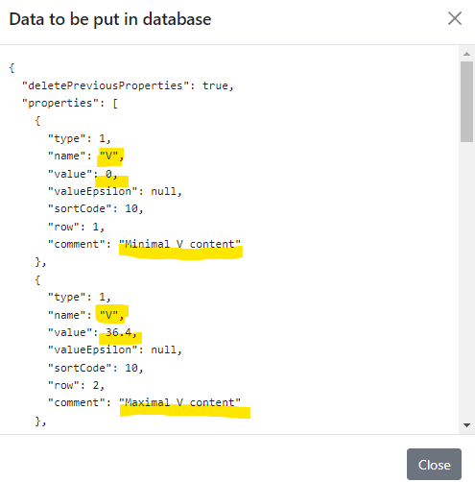
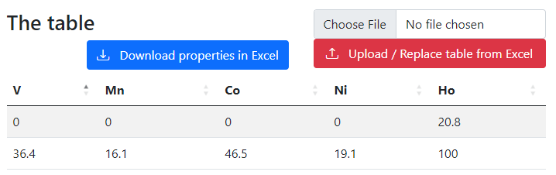
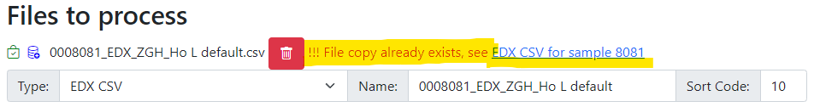
RDMS Drop Zone: Staged Files (before import)
Check data to import:
Properties
(after import):
Workflow:
- validate every file;
- check/adjust all properties;
- Import files.
Check for unique documents (based on SHA256):

Slide 18
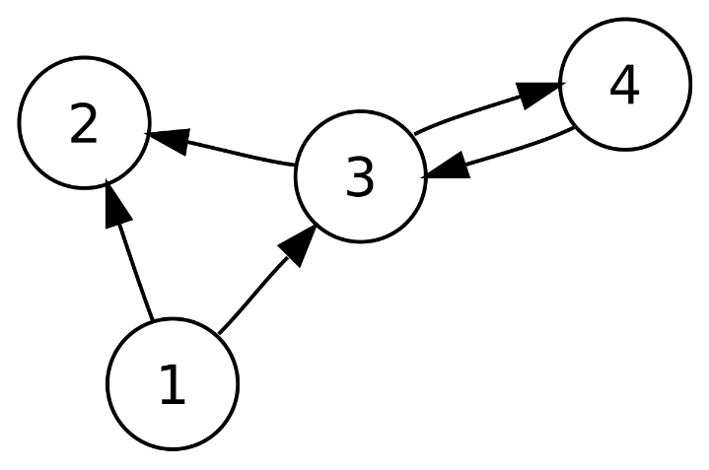
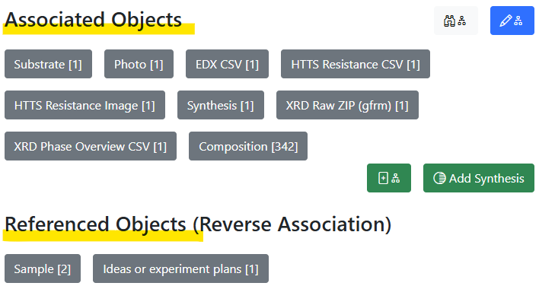
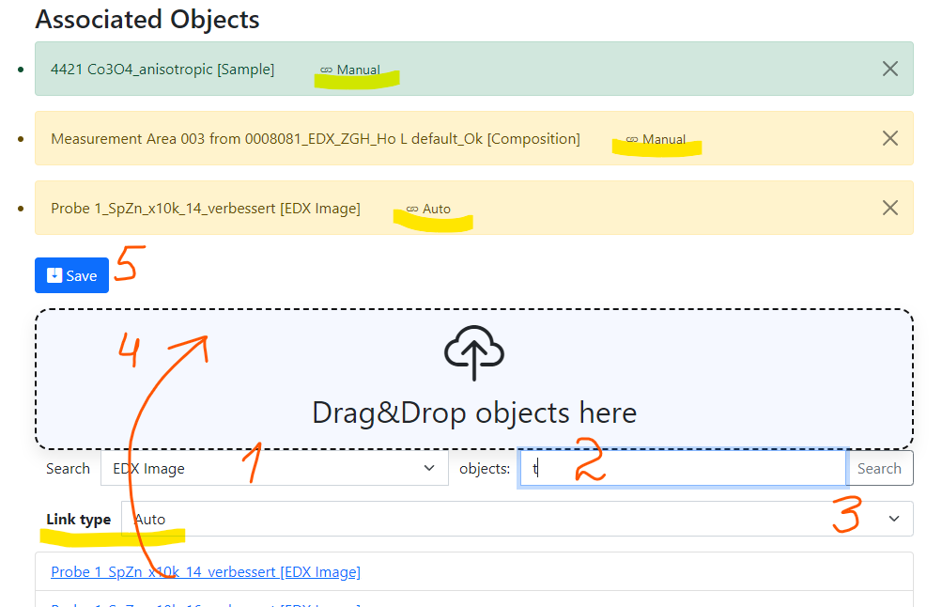
Graphs: Linking Objects
a
a
c
Example: establishing graph above objects
b
directed graph
To add associated objects:
0) Go to “List edit” or select object to edit
1) Select associated object type (optional filter)
2) Input search phrase, contained in the Name of the desired object to be associated
3) Select (if required) link/association type object.
4) Drag & Drop desired object(s) from search result list to the area / adjust list
5) Save changes
Important: Reverse associations allow to browse reverse- directional associations.
User view: https://demo.mdi.ruhr-uni-bochum.de/object/ag2s-4870
Admin view: https://demo.mdi.ruhr-uni-bochum.de/adminobject/edititem/4870

Slide 19
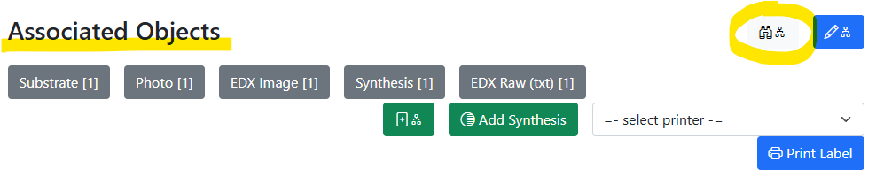
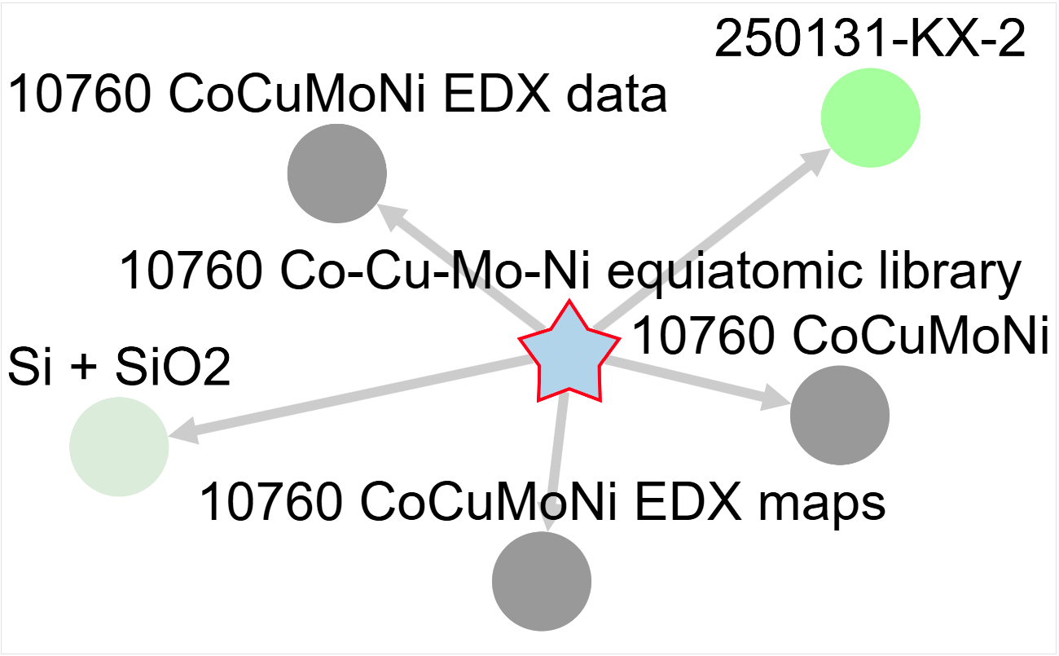
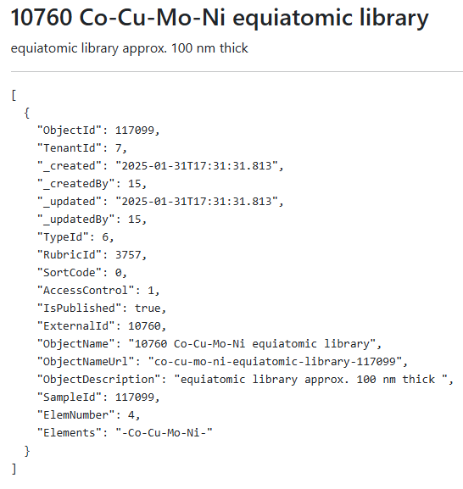
Graph visualisation
Motivation: understand relationship between objects
on double Click on the node:
incremental graph expansion (add parents/children)
Interactive graph
on Click: object description
JSON
https://mdi.matinf.pro/object/co-cu-mo-ni-equiatomic-library-117099
https://mdi.matinf.pro/object/graph/co-cu-mo-ni-equiatomic-library-117099

Slide 20
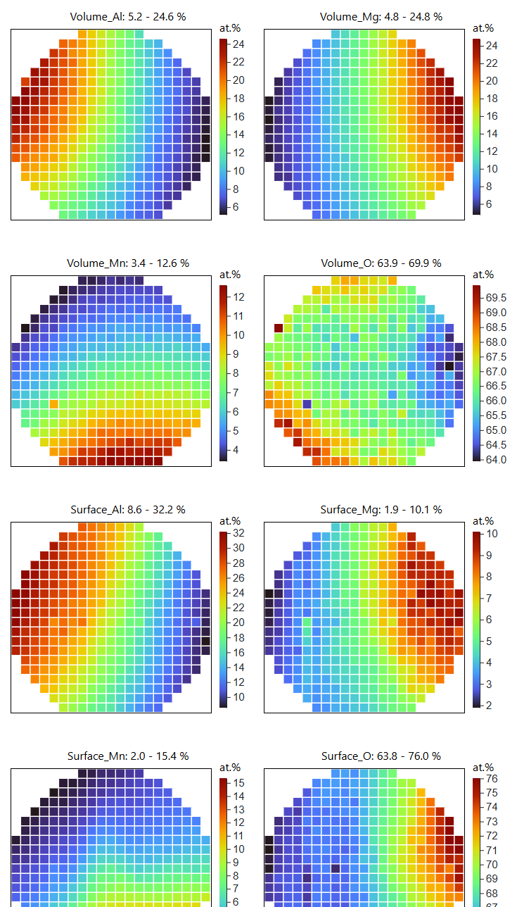
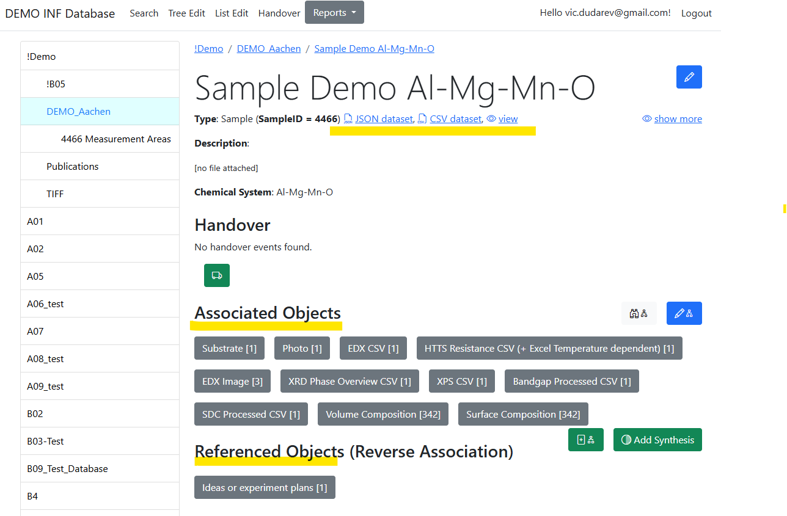
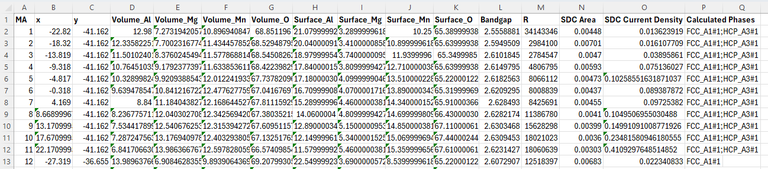
Data Integration
Example: Volume & Surface compositions, Bandgap, Resistance, Catalytic activity
https://inf.mdi.ruhr-uni-bochum.de/object/sample-demo-29196

Slide 21
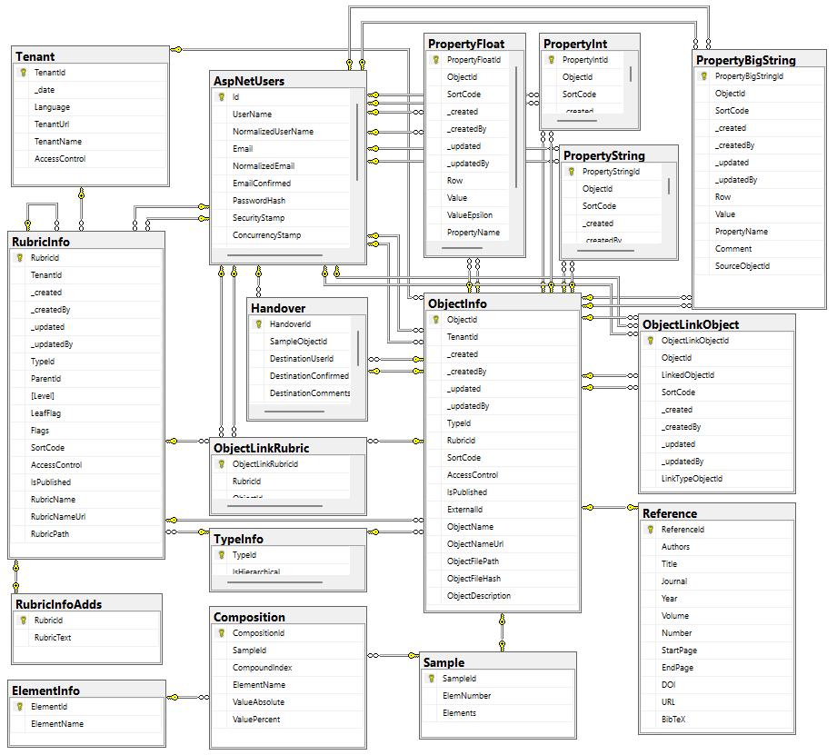

Data Acquisition API: Dashboards & Datasets
The RDMS exposes all data as read-only views
and downloadable documents
API user can introduce any queries over views
POST /vroapi/v1/execute
Executes SQL statement and returns a dataset (in JSON)
GET /vroapi/v1/download
Downloads document by specified identifier (ObjectId)
Database schema documentation:
https://crc1625.mdi.ruhr-uni-bochum.de/home/doc
https://crc1625.mdi.ruhr-uni-bochum.de/home/doc

Slide 22
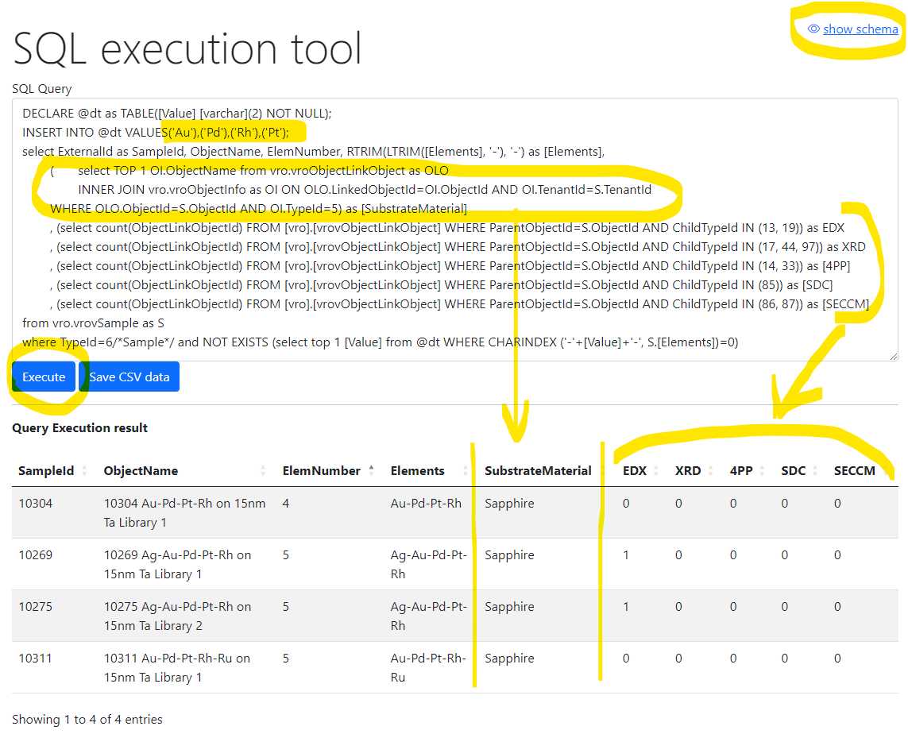
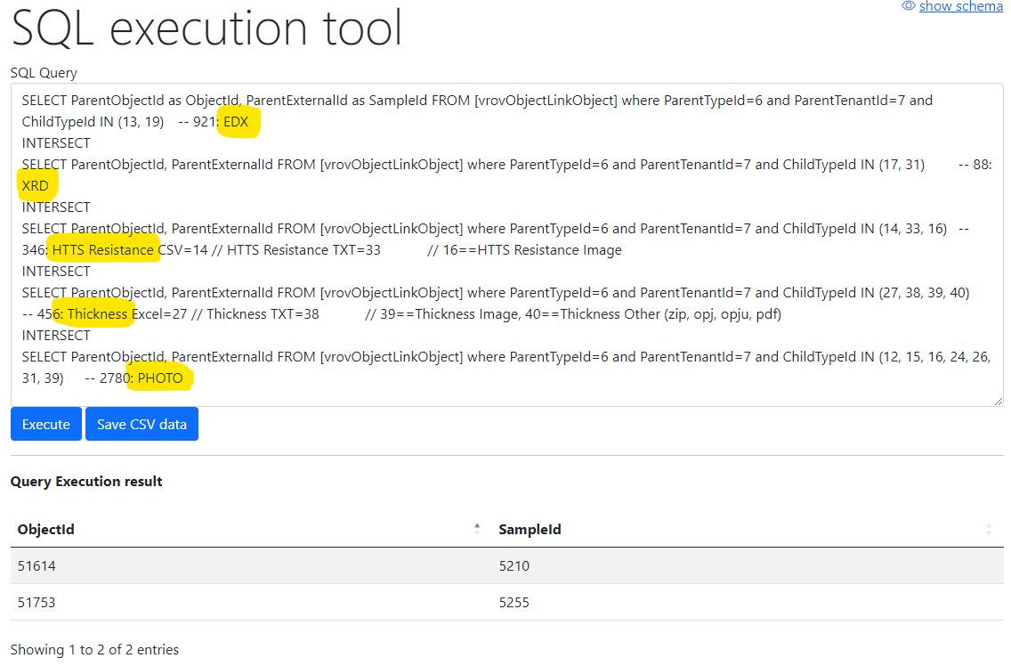
Flexible data queries for advances users
Show samples having Au-Pd-Rh-Pt and how many characterization documents for them we have (EDX, XRD, 4PP, SDC, SECCM)
Show samples (identifiers) that have all enlisted characterisations: EDX, XRD, Resistance, Thickness, Photo
https://mdi.matinf.pro/vroui
EDX - Energy-Dispersive X-ray spectroscopy; XRD - X-ray diffraction; 4PP – 4 Points Measurement (Resistance);
SDC - Scanning Droplet Cell; SECCM - Scanning ElectroChemical Cell Microscopy

Slide 23

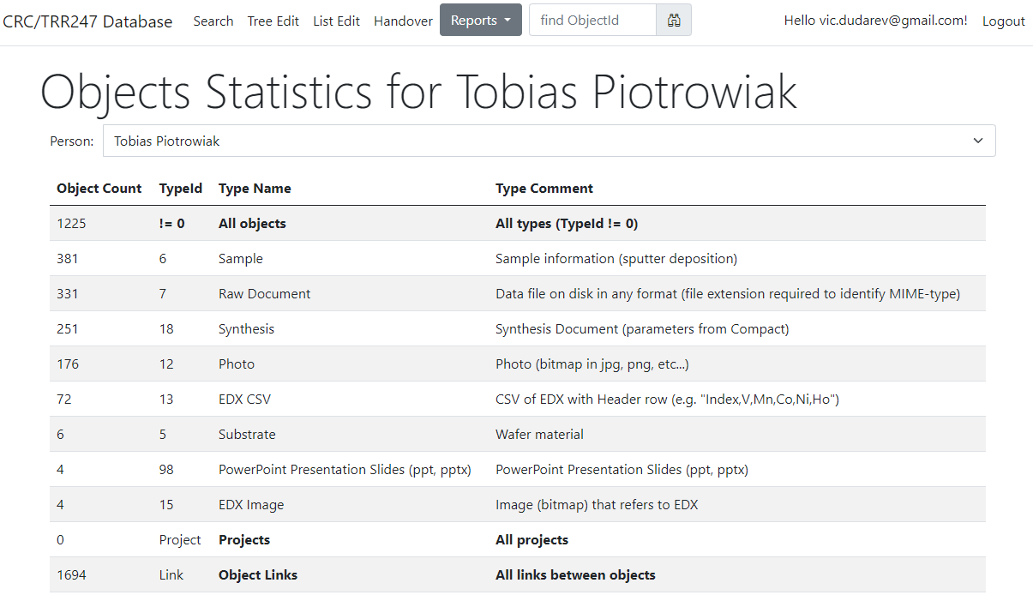
Reports & Statistics: Objects
Objects Statistics:
Objects (w.r.t. types)
Projects
Object Links
Feature:
Filter by person
https://crc247.mdi.ruhr-uni-bochum.de/report/objectsstatistics

Slide 24
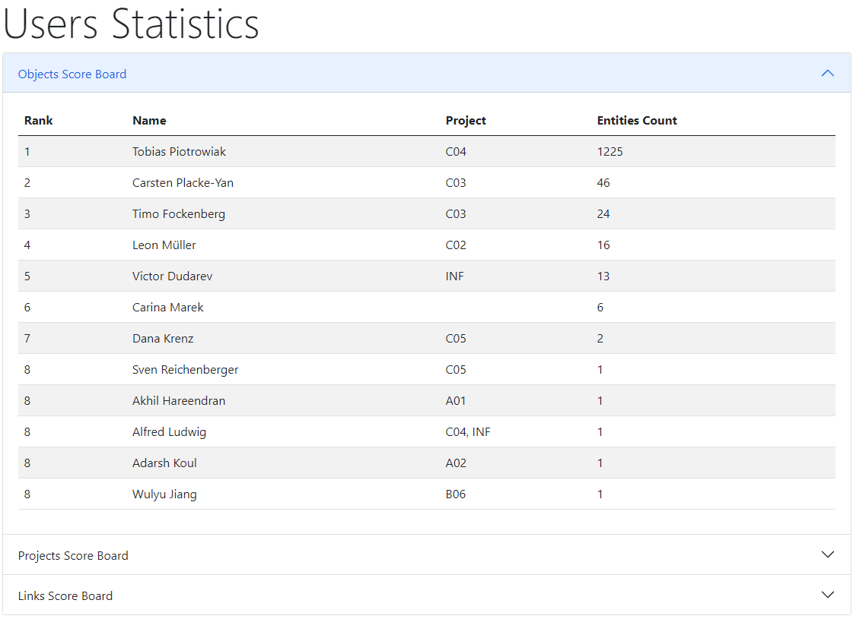

Reports & Statistics: Users
Users Statistics:
Objects
Projects
Links
https://crc247.mdi.ruhr-uni-bochum.de/report/usersstatistics

Slide 25
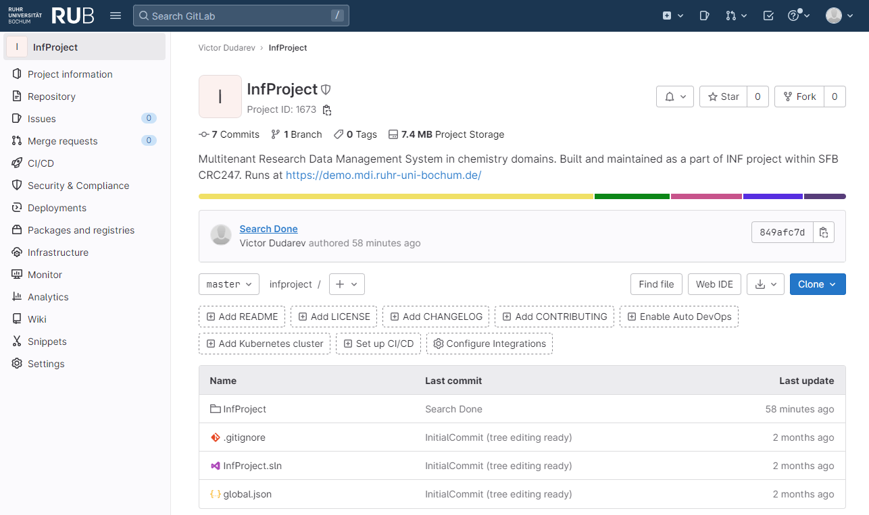

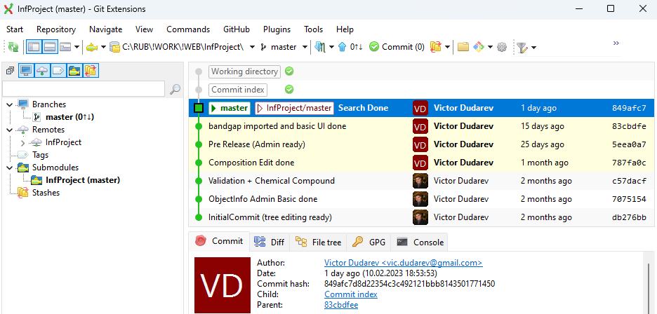



Core RDMS Contributions
Everybody’s welcome!
Feel free to contribute to open source!
Core INF project (ASP.Net Core / C#, MIT License):
https://gitlab.ruhr-uni-bochum.de/vic/infproject
Shared projects:
1) Administration User Interface (Identity Manager UI):
https://gitlab.ruhr-uni-bochum.de/vic/identitymanagerui
2) Web Application General Library (WebUtilsLib):
https://gitlab.ruhr-uni-bochum.de/vic/webutilslib
https://gitlab.ruhr-uni-bochum.de

Slide 26
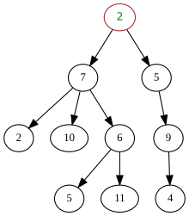


Conclusion¹: Data structures
Free open-source RSMS for materials science with an
extensible object type system.
Project tree Objects (Documents) Object Description
tree
a
a
key-value pairs
c
b
directed graph
table

Slide 27

Conclusion²: Functionality
Support for multiple Tenants;
Custom Project Tree & Objects Management
Batch Import of Documents
Extensible object Properties;
User-defined Object Type support:
  Document Validation
  Data Extraction
  Data Visualization
  Properties Templates
  Table Templates
Handovers
Reporting
APIs
UI Customization
System
(qualitative composition)
Co-O
Substance
(quantitative composition)
Co₃O₄
Modification
(crystal structure type)
β-Co₃O₄
…
RDMS: Research Data Management System

Slide 28
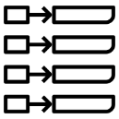

Conclusion³: towards AI-ready datasets
Document-oriented Graph Factographic
project
project
project
1
1
1
key-value
subproject
subproject
subproject
subproject
subproject
subproject
2
3
4
5
6
2
3
4
5
6
2
3
4
5
6
subsubproject
subsubproject
subsubproject
7
7
7
table
RDMS: Research Data Management System

Slide 29
High-throughput Experiments & Research Data Management
Notes:
https://qr.io/

Slide 30
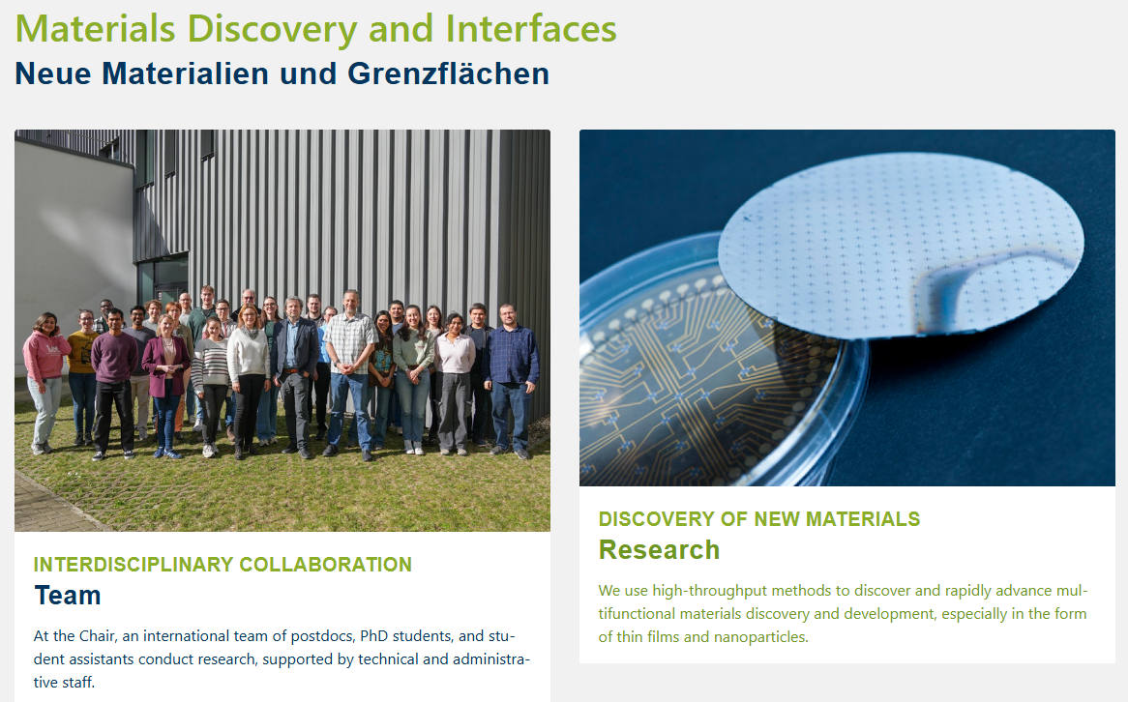
Materials Discovery and Interfaces (MDI) Chair
https://www.mdi.ruhr-uni-bochum.de/index.html.en

Slide 31
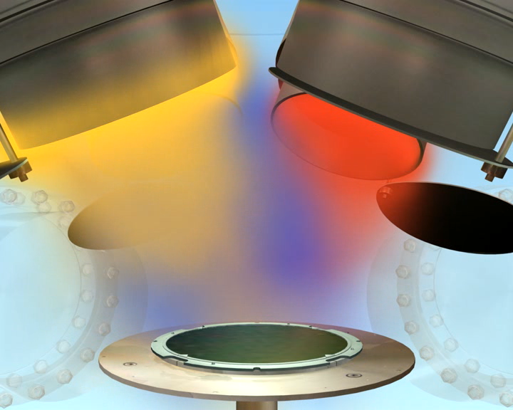
What we do: Combinatorial Magnetron Sputtering
cathode
Ar
permanent magnets
target
O₂
field lines
e⁻
e⁻
$$hν$$
+
+
+
ionization
DC/RF
Ar⁺
+
recombination
spontaneous ionization
$$hν$$
desorption
diffusion
substrate
table
anode

Slide 32
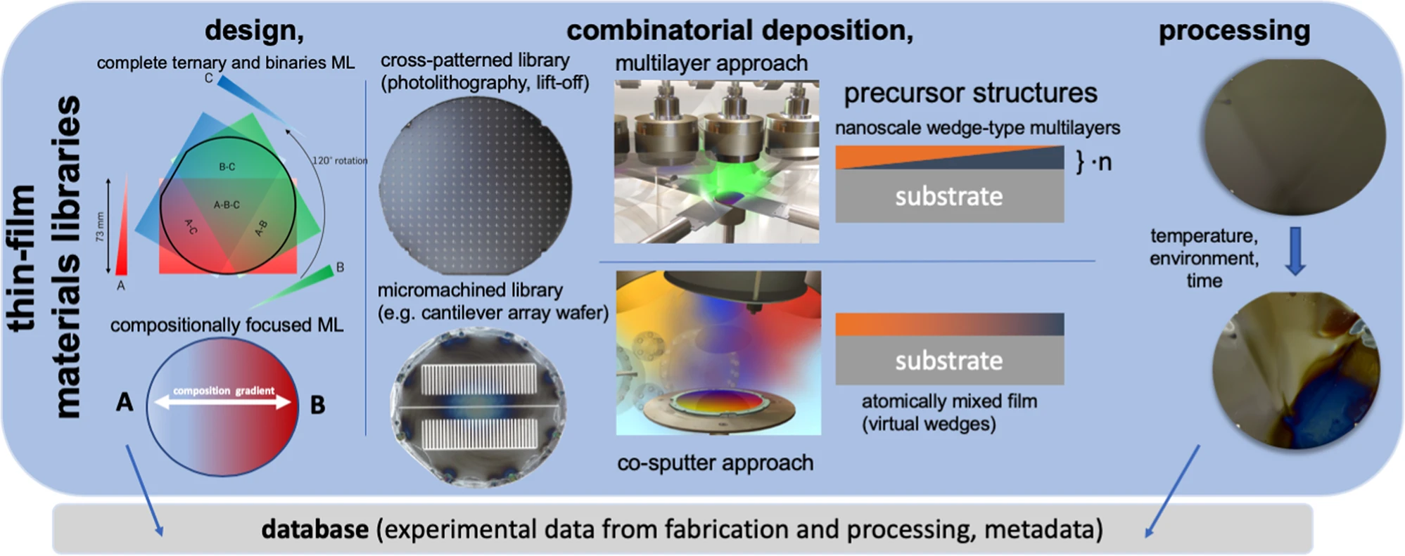
Materials Discovery and Interfaces (MDI) Research
Goal: provide Research Data Management Support for Combinatorial Materials Science and High-Throughput Methods
RDMS – Research Data Management System

Slide 33
Object Graph as a Research Workflow Representation
Defines characterisations
Provides report on samples & measurements
Idea or Plan
Calculation / Compu-tational Composition
Treatment:
annealing,
oxidation,
polishing, …
Report / Publication
Sample
Sample_2
Request for Synthesis
Characterisation:
EDX, XRD, Resistance, Bandgap, …
Characterisation:
EDX, XRD, Resistance, Bandgap, …
EDX – Energy-Dispersive X-ray spectroscopy (to determine composition) XRD – X-Ray Diffraction (to determine crystallographic structure)

Slide 34
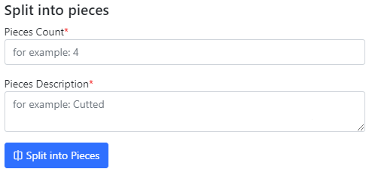
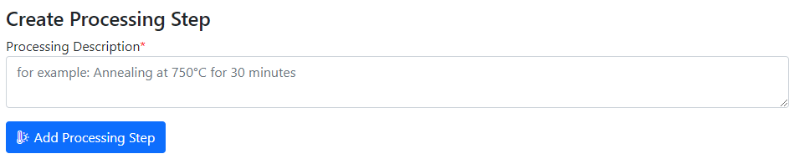
Use Case: Sample Transformation Workflow
Create Processing State & Split Sample
Sample_2a_2
(subsample 2a state 2)
polishing
Documents2a_2
Sample_2a
(subsample 2a)
Sample
(initial state)
annealing
Sample_2
(changed state 2)
splitting
Sample_2b_2
(subsample 2b state 2)
oxidation
Sample_2b
(subsample 2b)
Documents
Documents2
Documents2b_2

Slide 35
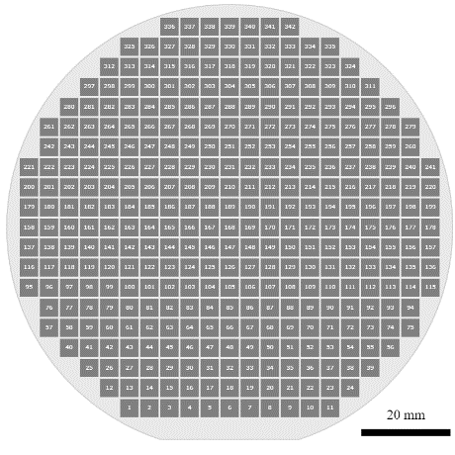
Integration of heterogeneous measurements
Typical Materials Library Data Lifecycle:
Sputtering:
Add Sample object (chemical system + substrate)
Measurement Area
(composition)
Add Synthesis object (sputtering parameters)
Phases: [ Phase₁,
…, Phase_{N} ]
Resistance: __ Ohm
Thickness: __ nm
Bandgap: __ eV
…
Characterisation:
Add processed EDX (342 Composition objects)
  Composition == Measurement Area
Add Other Characterisation Documents (XRD, Resistance, Thickness, Bandgap, etc…)
Storage, Curation, Search (on properties retrieved from devices / file formats), Reporting:
Find compositions with given properties in a certain range (across all known materials libraries)
Find by synthesis parameters
Find by chemical system / properties / creation date / author / text, etc…
Reports
ML – Materials Library MA – Measurement Area (a certain part of Materials Library (ML) surface)
EDX – Energy-dispersive X-ray spectroscopy XRD – X-ray diffraction analysis

Slide 36
Data extraction: adding data to Compositions (MAs)
{
"CompositionsForSampleUpdate": [
{
"Predicate": {
"Properties": [
{
"Type": 2,
"Name": "Measurement Area",
"Value": 1
}
]
},
"DeletePreviousProperties": false,
"Properties": [
{
"PropertyId": 0,
"Type": 1,
"Name": "R",
"Value": 34143346,
"ValueEpsilon": null,
"SortCode": 10,
"Row": null,
"Comment": "Resistance (Room Temperature) for Measurement Area 1"
}
]
},
...
],
"DeletePreviousProperties": true,
"Properties": [
{
"PropertyId": 0,
"Type": 1,
"Name": "R",
"Value": 97692.43229,
"ValueEpsilon": null,
"SortCode": 10,
"Row": 1,
"Comment": "Minimal Resistance (Room Temperature) of Materials Library (of all 342 MAs)"
},
{
"PropertyId": 0,
"Type": 1,
"Name": "R",
"Value": 34143346,
"ValueEpsilon": null,
"SortCode": 10,
"Row": 2,
"Comment": "Maximal Resistance (Room Temperature) of Materials Library (of all 342 MAs)"
}
]
}
Use case: adding characterisation data after EDX is done.
Resistance for MA 1
Sample
EDX
Composition
R
Resistance
x 342
Resistance range for the sample (whole ML)
Data import:
Locate parent sample object.
Find measurement area collection.
Find a certain Measurement Area (corresponding to a predicate, e.g. MA index).
Add properties values to a composition corresponding to a measurement area index.
http://htts.matinf.pro/

Slide 37
Data Integration
Example: Volume & Surface compositions, Bandgap, Resistance, Catalytic activity
https://inf.mdi.ruhr-uni-bochum.de/object/sample-demo-29196

Slide 38
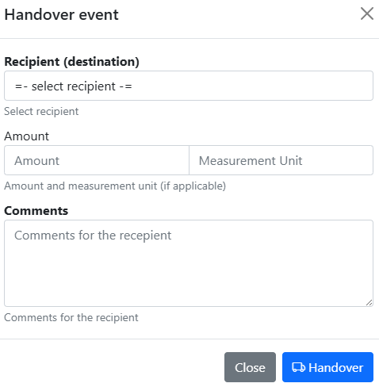
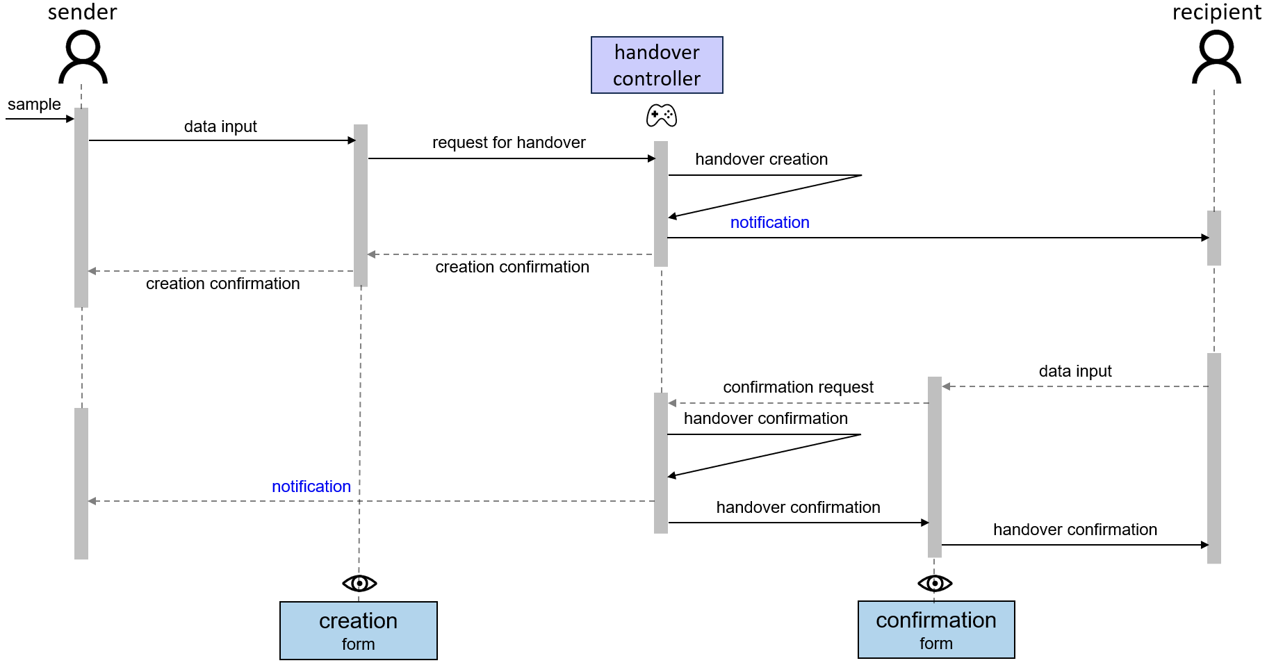

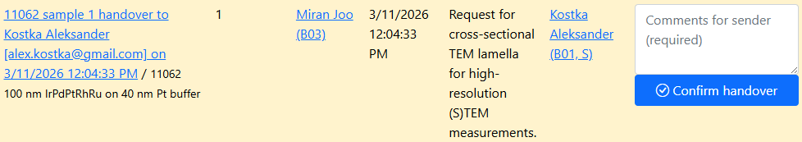

Handovers Workflow: Tracking Samples
Motivation: trace samples (who holds the sample?)
https://crc1625.mdi.ruhr-uni-bochum.de/rubric/s

Slide 39



Tracking Samples or Handover event: initialisation
Motivation (C03): to track sample location / shipping
In “physically transferrable” objects (samples), find a green handover button
Select the recipient and press a blue button.
Select recipient
Specify Amount (optional)
Specify Comments
click

Slide 40



Tracking Samples or Handover event: delivering / delivered
Handover event is created
Recipient is notified by e-mail
3) Recipient should add comments and confirm the handover.
4) Confirmed
+ e-mail notification for sender

Slide 41

Tracking Samples or Handover event: user overview
Incoming
Outgoing
https://crc247.mdi.ruhr-uni-bochum.de/handover

Slide 42

Tracking Samples or Handover event: project overview
Pending handovers (unconfirmed)
Successful handover
https://crc247.mdi.ruhr-uni-bochum.de/rubric/area-c_c03

Slide 43




RDMS: Is my data safe?
IC OST Server Room
RUB DC
2 km
Main
Daily/weekly backups
Data
External
Storage
Weekly
backups
Backup
Monitoring
Compute
https://matinf.pro/crc247-fp2-inf-report.htm

Slide 44

Live Demo: Getting a Composition-Property Dataset
Goal: explore a materials library and get composition-property dataset
Workflow:
Create a materials library (Sample) & create Sample (Synthesis?) object in RDMS
Measure compositions in a high-throughput way (EDX) & upload to RDMS
Measure property (4PP Resistance) in a high-throughput way & upload to RDMS
In RDMS: download a dataset (in CSV), containing 342 composition-property data points
In RDMS: visualize a composition-property dataset and draw conclusions
Sample
EDX
4PP
Resistance
EDX – Energy-Dispersive X-ray spectroscopy (to determine composition) 4PP – 4-Point Probe structure)

Slide 45
Motivation: Referencing Data in Papers
Prof. Doris Segets (Uni-UDE):
“paper statement «data available on the request» almost killed CRC 1411”.
Conclusion: no "data available on the request" => RDMS => DOI
Our step-by-step actions:
Store all data in RDMS (protected by default);
Make the data public (if it supports a publication; use an “idea or plan”);
Get DOI for data and reference it in your publication: make a copy of publication’s data in Zenodo to get DOI.
Benefits: FAIR Open Data == Data reuse in future (essential for projects to survive / don’t repeat yourself or colleagues). Be FAIR!
How to do it in a right way?
FAIR: https://www.go-fair.org/fair-principles/

Slide 46


Data publication requirements: Nature Scientific Data case
Dataset deposition requirements:
Repository policy:
https://www.nature.com/sdata/submission-guidelines
https://www.nature.com/sdata/policies/repositories

Slide 47



CRC 1625 Repository on FAIRsharing.org
CRC 1625 Repository Recognition
after rigorous peer-review process.
Implication:
CRC 1625 Repo satisfies strict Springer Data Repository Guidance rules.
Conclusion:
CRC 1625 Repo can be user to publish data in Nature Scientific Data, etc...
https://fairsharing.org/FAIRsharing.76c84e
DOI: https://doi.org/10.25504/FAIRsharing.76c84e

Slide 48

Data Publication workflow: a plan
Prerequisite: you have data
Goal: publish a Data Paper
Steps:
For the subgraph: enable public access and harmonize licenses
Create data snapshot (zip archive)
Archive a snapshot on Zenodo in the CRC 1625 community and get DOI
Write down DOI in the RDMS in the root object “Idea or Plan” object
Optional: create a notebook in Jupyter4NFDI and reference both RDMS and Zenodo
Use a template to create a “Data Availability Statement”
Use a template to create a “Code Availability Statement”

Slide 49




Dual Data Access Publication Strategy
Live Research Data Layer
Archival Snapshot Layer
The Project Community on Zenodo
project
Research snapshots
1
key-value
Version 1 (DOI)
subproject
subproject
2
3
4
6
Bi-directional links
5
Version 2 (DOI)
subsubproject
7
table
…

Slide 50


Reproducibility via executable documents
Jupyter4NFDI:
offers centralized service for Jupyter Notebooks
available within and beyond the NFDI
simplifies user access (via IAM4NFDI)
repo2docker integration
custom docker images
Real-Time Collaboration (concurrent team work)
Storage Mount
shareable links (PID) for Jupyter configurations
https://base4nfdi.de/projects/jupyter4nfdi
https://nfdi-jupyter.de/
https://hub.nfdi-jupyter.de/ IAM - Identity and Access Management

Slide 51

Reproducibility: a persistent link to an executable
https://hub.nfdi-jupyter.de/
https://hub.nfdi-jupyter.de/share/BsvE41x7KW4

Slide 52

Reproducibility example: an EDX visualization
https://hub.nfdi-jupyter.de/
https://hub.nfdi-jupyter.de/share/BsvE41x7KW4

Slide 53


Triad for a perfect publication support
DOI
Live Research Data Layer
Archival Snapshot Layer
Persistent URLs (PIDs)
URL:
Live data
DOI:
Data archive
replicability
reproducibility
Executable documents
DOI – Digital Object Identifier
URL – Uniform Resource Locator
PID – Persistent Identifier

Slide 54

Licenses in objects
Goal: accompany objects/data with explicit data sharing terms.
Default: tenant’s license (CC BY 4.0), configured for a tenant
Adjustment – set License (String) property for the object:
Name: “License”
Value: <License_Name> (e.g., “CC BY 4.0”)
Comment: <License_URL> (e.g., “https://creativecommons.org/licenses/by/4.0/”)
https://crc1625.mdi.ruhr-uni-bochum.de/object/sample-6751-pt-piece-1-230878
Possible licenses: https://creativecommons.org/licenses/

Slide 55
RDMS Access Levels
Motivation:
Managing data access policy using the Access Control attribute at the individual object level.
RDMS data access policy is controlled via Access Levels
Five Access Levels:
Public (for anonymous users, search engines):
    - objects are available to everybody regardless of authorization (visible to internet search engines);
^{NEW} Partner (for external users / collaborations)^{NEW}:
    - objects are visible to the authorized users with a Partner claim (and at least User role assigned);
Protected (by default, visible to the community only):
- objects are visible to the community (available to authorized users with at least User role assigned);
ProtectedNDA (restricted visibility):
- objects are visible to the authorized users (at least User role assigned) with NDA claim set OR to Administrators;
Private (person’s secret, but open for Administrators):
- objects are visible to the user-creator (at least PowerUser role assigned);
- objects are visible to all users of Administrator role.
relaxed
User’s Access Claim:
Partner
NDA
strict
Protected is default access level in the CRC
NDA - Non-Disclosure Agreement

Slide 56



Data publication
Goal:
Change Access Control for entire object graph
Making objects public
Detailed statistics:
Access Control
Licenses
Authors (Creators)
Full Object list for a graph
https://crc247.mdi.ruhr-uni-bochum.de/adminobject/edititem/30212/?returl=%2Fobject%2Fla-co-ni-o-exploration-147192
https://crc247.mdi.ruhr-uni-bochum.de/adminobject/editgraph/30212?mode=AccessControl

Slide 57
Data snapshot script
Python code on the top of VRO API
Goal:
Create a graph snapshot (folder with (meta)data) to publish on external repositories (Zenodo, etc).
Input:
Tenant URL (https://crc1625.mdi.ruhr-uni-bochum.de)
VRO API Key (assigned to user by an administrator upon request; to do: GUI for power users…)
root ObjectId (top-level object, e.g., “idea or experiment plan”)
Output:
A folder that contains:
readme.md (+ links to live data)
index.html (+links to live data)
Data folder (with CSV and JSON)
  + index.csv / index.json – all basic objects metadata in a graph
Documents (with files associated)
https://gitlab.ruhr-uni-bochum.de/vic/infproject/-/tree/master/SCRIPTS/Extract_ExperimentData
python VroApi.py --object-id 30212 --tenant-url "https://crc247.mdi.ruhr-uni-bochum.de" --api-key "<VRO_API_Key>" --publish-dir "Publish"

Slide 58
DOI: Snapshot archival (publication) script
Python code on the top of Zenodo API
Goal:
Zip data and create a Zenodo publication to mint a DOI.
Input:
ZenodoConnection.json (API token; IsSandbox)
PublicationMetadata.json (title, authors, keywords, license, Zenodo community [CRC <N>], etc…)
Data folder (to make a Zip-archive and sent to Zenodo)
Output:
A Zenodo record with URL/DOI
Create DOI property in the “idea or experiment plan” object.
data.zip
DOI
https://gitlab.ruhr-uni-bochum.de/vic/infproject/-/tree/master/SCRIPTS/PublishToZenodo
python “Publish" ZenodoConnection_Sandbox.json PublicationMetadata_Sandbox.json false
DOI – Digital Object Identifier

Slide 59
Data Availability Statement
Goal:
reference archival data snapshot (DOI)
reference live research data (URL)
A typical Data Availability Statement for a dual data access strategy implemented can be:
Just fill in placeholders
The research data supporting the findings of this study are publicly available through the Zenodo repository under DOI: <DOI>. The published dataset represents an archival snapshot corresponding to the data used in this publication.
The current version of the dataset, including subsequent updates and corrections, is available through the MatInf Research Data Management System at: <URL_idea_plan>.

Slide 60
Code Availability Statement
Goal:
reference executable documents / notebooks with reproducibility (URL_Jupyter4NFDI)
reference source code used during publication (DOI_source_code)*
reference source code repository to provide access to the last source code version (URL_public_Git_repository)
A typical Code Availability Statement for a complete publication triad implemented can be:
just fill in placeholders
The computational workflows used to generate the results presented in this study are available as Jupyter notebooks at: <URL_Jupyter4NFDI>. The notebooks contain all scripts, processing steps, and visualization procedures required to reproduce the analyses described in this publication.
Complete source code corresponding to the one used in this publication is available on Zenodo at: <DOI_source_code>. Current source code version is available at: <URL_public_Git_repository>.
* Zenodo is integrated with GitHub and can create snapshots of the source code as associate DOI to them

Slide 61


Summary: publication workflow
Prerequisite: you have data
Goal: publish a Data Paper
Steps:
For the subgraph: enable public access and harmonize licenses
  In the RDMS GUI:
Create data snapshot (extract all the subgraph)
  py-script in /Scripts/Extract_ExperimentData
Archive a snapshot on Zenodo in the CRC community and get DOI
  py-script in /Scripts/PublishToZenodo or Zenodo GUI (community)
Write down DOI in the RDMS in the root object “Idea or Plan” object
  In the RDMS GUI:
Optional: create notebook(s) in Jupyter4NFDI and reference both RDMS and Zenodo
  Use https://hub.nfdi-jupyter.de/
Use a template to create a “Data Availability Statement”
Optional: use a template to create a “Code Availability Statement”
public
data.zip
DOI

Slide 62

RDMS Free Playground
Questions & Answers
Thanks for your kind attention
  https://inf.mdi.ruhr-uni-bochum.de/
Playground to test RDMS (multiple tenants with shared users list):
https://inf.mdi.ruhr-uni-bochum.de/
Login and Password (User role): User1@user.org
Login and Password (PowerUser role): PowerUser1@user.org
Login and Password (Administrator role): Admin1@user.org
https://vdudarev.ru
Notes:
https://qr.io/

Slide 63
Outlook: Architecture
Application Services
Web Application
users
Visualisation
Controller
View
Web API Services
Model
API
agents
Validation
Data Access Layer
Data Extraction
Dapper
IO (SMB/S3)
Queue
External Type Support Services
Database
File Storages
Apache
Kafka
Database
Databases
Storage Services
Message Bus
MatInf – Research Data Management System

